Slide 1
Restoring Burnt Stones
Nehemiah 4:1-3; Nehemiah 1:1-4 (NIV)
Sunday, January 11, 2015
Wayne Hartsgrove

Slide 2
Nehemiah 4:1-3 (NIV)
Opposition to the Rebuilding
4 When Sanballat heard that we were rebuilding the wall, he became angry and was greatly incensed. He ridiculed the Jews, ² and in the presence of his associates and the army of Samaria, he said, “What are those feeble Jews doing? Will they restore their wall? Will they offer sacrifices? Will they finish in a day? Can they bring the stones back to life from those heaps of rubble—burned as they are?”
³ Tobiah the Ammonite, who was at his side, said, “What they are building—even a fox climbing up on it would break down their wall of stones!”

Slide 3
Nehemiah 1:1-4 (NIV)
Nehemiah’s Prayer
1 The words of Nehemiah son of Hakaliah:
In the month of Kislev in the twentieth year, while I was in the citadel of Susa, ² Hanani, one of my brothers, came from Judah with some other men, and I questioned them about the Jewish remnant that had survived the exile, and also about Jerusalem.
³ They said to me, “Those who survived the exile and are back in the province are in great trouble and disgrace. The wall of Jerusalem is broken down, and its gates have been burned with fire.”
⁴ When I heard these things, I sat down and wept. For some days I mourned and fasted and prayed before the God of heaven.

Slide 4
1.
True religion is to visit the widows and orphans.
James 1:27 (NIV)
²⁷ Religion that God our Father accepts as pure and faultless is this: to look after orphans and widows in their distress and to keep oneself from being polluted by the world.

Slide 5
2.
Passionless Christianity is a curse.

Slide 6
3.
Sanballet is a picture of satan.

Slide 7
4.
Its always in the heart of God to restore burnt stones.

Slide 8
5.
Burnt stones are a prophetic picture of people.

Slide 9
6.
God uses the word stone in the bible to describe people.

Slide 10
7.
God sends Nehemiah to find the burnt stones and to pick them up and restore them.

Slide 11
8.
Nehemiah’s name means Comfort of God.

Slide 12
9.
There is no believer in Christ who is not called to restore burnt stones.
TRUE

Slide 13
10.
Memorize Galatians 6:1 on your own.
Galatians 6:1 (NIV)
Doing Good to All
6 Brothers and sisters, if someone is caught in a sin, you who live by the Spirit should restore that person gently. But watch yourselves, or you also may be tempted.

Slide 14
11.
Steps to restoration:
Be willing to go.
Go back to where you lost it.
Stretch out and pick it up.

Slide 15
James 1:27 (NIV)
²⁷ Religion that God our Father accepts as pure and faultless is this: to look after orphans and widows in their distress and to keep oneself from being polluted by the world.

Slide 16
John 10:10 (NIV)
¹⁰ The thief comes only to steal and kill and destroy; I have come that they may have life, and have it to the full.

Slide 17
Matthew 9:35-36 (NIV)
The Workers Are Few
³⁵ Jesus went through all the towns and villages, teaching in their synagogues, proclaiming the good news of the kingdom and healing every disease and sickness. ³⁶ When he saw the crowds, he had compassion on them, because they were harassed and helpless, like sheep without a shepherd.

Slide 18
Galatians 6:1 (NIV)
Doing Good to All
6 Brothers and sisters, if someone is caught in a sin, you who live by the Spirit should restore that person gently. But watch yourselves, or you also may be tempted.

Slide 19
2 Kings 6:1-6 (NIV)
An Axhead Floats
6 The company of the prophets said to Elisha, “Look, the place where we meet with you is too small for us. ² Let us go to the Jordan, where each of us can get a pole; and let us build a place there for us to meet.”
And he said, “Go.”
³ Then one of them said, “Won’t you please come with your servants?”
“I will,” Elisha replied. ⁴ And he went with them.
They went to the Jordan and began to cut down trees. ⁵ As one of them was cutting down a tree, the iron axhead fell into the water. “Oh no, my lord!” he cried out. “It was borrowed!”
⁶ The man of God asked, “Where did it fall?” When he showed him the place, Elisha cut a stick and threw it there, and made the iron float.

Slide 20
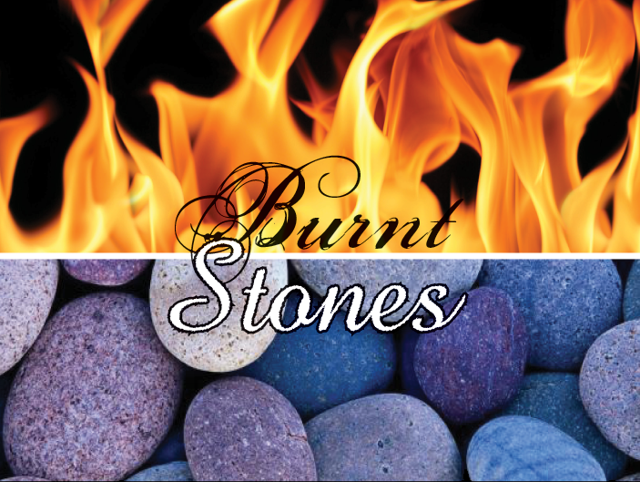
Restoring Burnt Stones
Nehemiah 4:1-3; Nehemiah 1:1-4 (NIV)

