Slide 1
Are You All In Or All Out?
1 Samuel 22:2
Sunday, February 15, 2015
Wayne Hartsgrove

Slide 2
² And everyone who was in distress, everyone who was in debt, and everyone who was discontented gathered to him. So he became captain over them. And there were about four hundred men with him.
1 Samuel 22:2 (NKJV)

Slide 3
Questions
&
Answers

Slide 4
How many men were in David’s army about 400 .

Slide 5
There’s a big difference between a family and an army.

Slide 6
The family is held together by a bond of love and blood.

Slide 7
An army is held together by vision and order.

Slide 8
In Luke 19:13 Occupy until I come Jesus is saying to His Church ”Occupy until I come”.
¹³ And he called his ten servants, and delivered them ten pounds, and said unto them, Occupy till I come.
Luke 19:13 (KJV)

Slide 9
Memorize Luke 10:19 on your own!
¹⁹ Behold, I give you the authority to trample on serpents and scorpions, and over all the power of the enemy, and nothing shall by any means hurt you.
Luke 10:19 (NKJV)

Slide 10
We are not just the family of God, we are the army of God!

Slide 11
As the army of God we must go through a process.
It’s difficult because it feels like we’re alone.
As a part of God’s elite army we can’t rely on a majority consensus.
God’s elite army requires that we are all in.
It means that we can possibly be misunderstood by nominal Christians.
Being a part of God’s elite army can also run the risk of being labeled as extreme and radical by mainstream religion.

Slide 12
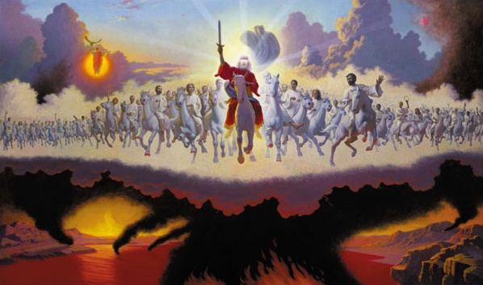
Are You All In Or All Out?
1 Samuel 22:2

