Slide 1
Your Abundance
Is Just Beyond
Your Nothing
1 Kings 18:41-46; Acts 12:1
(NKJV)
Sunday, March 1, 2015
Wayne Hartsgrove

Slide 2
⁴¹ Then Elijah said to Ahab, “Go up, eat and drink; for there is the sound of abundance of rain.” ⁴² So Ahab went up to eat and drink. And Elijah went up to the top of Carmel; then he bowed down on the ground, and put his face between his knees, ⁴³ and said to his servant, “Go up now, look toward the sea.”
So he went up and looked, and said, “There is nothing.” And seven times he said, “Go again.”
1 Kings 18:41-43 (NKJV)

Slide 3
⁴⁴ Then it came to pass the seventh time, that he said, “There is a cloud, as small as a man’s hand, rising out of the sea!” So he said, “Go up, say to Ahab, ‘Prepare your chariot, and go down before the rain stops you.’”
⁴⁵ Now it happened in the meantime that the sky became black with clouds and wind, and there was a heavy rain. So Ahab rode away and went to Jezreel. ⁴⁶ Then the hand of the Lord came upon Elijah; and he girded up his loins and ran ahead of Ahab to the entrance of Jezreel.
1 Kings 18:44-46 (NKJV)

Slide 4
12 Now about that time Herod the king stretched out his hand to harass some from the church.
Acts 12:1 (NKJV)

Slide 6
Who was the prophet that God raised up that would not be shaken during this time? Elijah

Slide 7
How many times does the same report come back to the prophet? 6 times.

Slide 8
What is the report? There is nothing.

Slide 9
Finally on the 7th time his servant returns with a side note. What is the side note? there is nothing but I saw a little cloud the size of a man’s hand.

Slide 10
Peter went from nothing to overflow.

Slide 11
God does His best work in the dark. God works the night shift.

Slide 12
God can make something out of nothing.

Slide 13
Your abundance is just beyond your nothing.

Slide 14
Start praising God like you believe Heaven’s weather report!

Slide 15
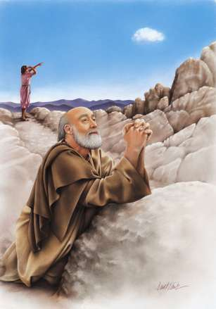
Your Abundance
Is Just Beyond
Your Nothing

