Slide 1

Get Agitated – Then Agitate
2 Timothy 1:1-16 (NIV)
Sunday, March 15, 2015
Wayne Hartsgrove

Slide 2

1 Paul, an apostle of Christ Jesus by the will of God, in keeping with the promise of life that is in Christ Jesus,
² To Timothy, my dear son:
Grace, mercy and peace from God the Father and Christ Jesus our Lord.
2 Timothy 1:1-2 (NIV)

Slide 3
³ I thank God, whom I serve, as my ancestors did, with a clear conscience, as night and day I constantly remember you in my prayers. ⁴ Recalling your tears, I long to see you, so that I may be filled with joy. ⁵ I am reminded of your sincere faith, which first lived in your grandmother Lois and in your mother Eunice and, I am persuaded, now lives in you also.
2 Timothy 1:3-5 (NIV)

Slide 4
⁶ For this reason I remind you to fan into flame the gift of God, which is in you through the laying on of my hands. ⁷ For the Spirit God gave us does not make us timid, but gives us power, love and self-discipline. ⁸ So do not be ashamed of the testimony about our Lord or of me his prisoner. Rather, join with me in suffering for the gospel, by the power of God. ⁹ He has saved us and called us to a holy life—not because of anything we have done but because of his own purpose and grace. This grace was given us in Christ Jesus before the beginning of time,
2 Timothy 1:6-9 (NIV)

Slide 5
¹⁰ but it has now been revealed through the appearing of our Savior, Christ Jesus, who has destroyed death and has brought life and immortality to light through the gospel. ¹¹ And of this gospel I was appointed a herald and an apostle and a teacher. ¹² That is why I am suffering as I am. Yet this is no cause for shame, because I know whom I have believed, and am convinced that he is able to guard what I have entrusted to him until that day.
2 Timothy 1:10-12 (NIV)

Slide 6
¹³ What you heard from me, keep as the pattern of sound teaching, with faith and love in Christ Jesus. ¹⁴ Guard the good deposit that was entrusted to you—guard it with the help of the Holy Spirit who lives in us.
2 Timothy 1:13-14 (NIV)

Slide 7
¹⁵ You know that everyone in the province of Asia has deserted me, including Phygelus and Hermogenes.
¹⁶ May the Lord show mercy to the household of Onesiphorus, because he often refreshed me and was not ashamed of my chains.
2 Timothy 1:15-16 (NIV)

Slide 8
Acts 2:2-4 (NKJV)
² And suddenly there came a sound from heaven, as of a rushing mighty wind, and it filled the whole house where they were sitting. ³ Then there appeared to them divided tongues, as of fire, and one sat upon each of them. ⁴ And they were all filled with the Holy Spirit and began to speak with other tongues, as the Spirit gave them utterance.

Slide 9
Acts 1:8 (NKJV)
⁸ But you shall receive power when the Holy Spirit has come upon you; and you shall be witnesses to Me in Jerusalem, and in all Judea and Samaria, and to the end of the earth.”

Slide 10
Acts 10:38 (NKJV)
³⁸ how God anointed Jesus of Nazareth with the Holy Spirit and with power, who went about doing good and healing all who were oppressed by the devil, for God was with Him.

Slide 11
1 John 3:8 (NKJV)
⁸ He who sins is of the devil, for the devil has sinned from the beginning. For this purpose the Son of God was manifested, that He might destroy the works of the devil.

Slide 12
1 John 4:17 (NKJV)
¹⁷ Love has been perfected among us in this: that we may have boldness in the day of judgment; because as He is, so are we in this world.

Slide 13
Acts 4:29-31 (NKJV)
²⁹ Now, Lord, look on their threats, and grant to Your servants that with all boldness they may speak Your word, ³⁰ by stretching out Your hand to heal, and that signs and wonders may be done through the name of Your holy Servant Jesus.”
³¹ And when they had prayed, the place where they were assembled together was shaken; and they were all filled with the Holy Spirit, and they spoke the word of God with boldness.

Slide 15
The most important experience you and I can have is salvation.

Slide 16
Salvation means to confess our sins, to forsake/abandon our sins, and to ask Jesus to be our Savior.

Slide 17
Memorize John 3:3. Born again means saved, changed, set free.
³ Jesus answered and said to him, “Most assuredly, I say to you, unless one is born again, he cannot see the kingdom of God.”
John 3:3 (NKJV)

Slide 18
The ministry of Jesus was
to seek and to save that which was lost.
to establish the kingdom of God in the earth.
to destroy the works of the devil.

Slide 19
According to Acts 2:1-4, how many were filled with the Holy Spirit and spoke in tongues? All
2 When the Day of Pentecost had fully come, they were all with one accord in one place. ² And suddenly there came a sound from heaven, as of a rushing mighty wind, and it filled the whole house where they were sitting. ³ Then there appeared to them divided tongues, as of fire, and one sat upon each of them. ⁴ And they were all filled with the Holy Spirit and began to speak with other tongues, as the Spirit gave them utterance.
Acts 2:1-4 (NKJV)

Slide 20
We need God to interrupt our saying by His doing.

Slide 21
The first step to agitation, stirring the flame of the Holy Spirit in us, is to remove anything that is flame resistant.

Slide 22
Flame resistant in this context means to repent of allowing the accumulation of junk, sin, in our lives.

Slide 23
To agitate means to stir up the gift of the Holy Spirit in us as believers.

Slide 24
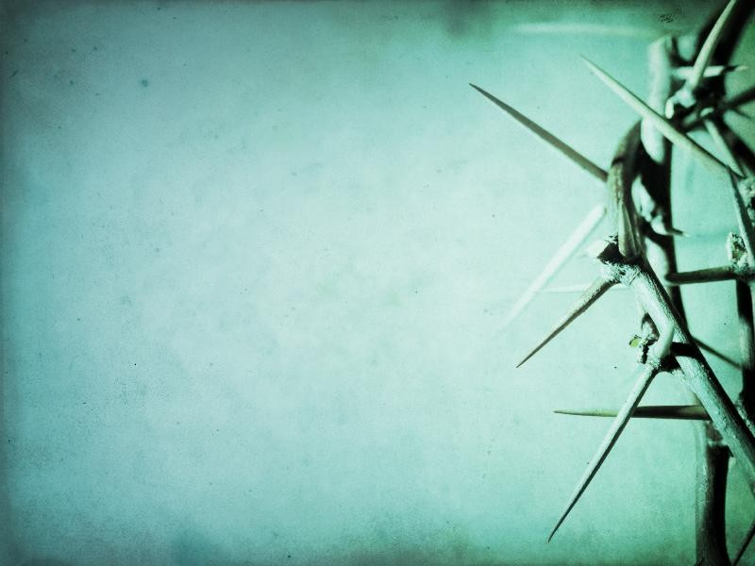
Get Agitated – Then Agitate
Stir up the gift of God
which is in you.
2 Timothy 1:6

