Slide 1

Don’t
Miss It
This
Time
John 5:1-9 (NIV)
Sunday, March 22, 2015
Wayne Hartsgrove

Slide 2

5 Some time later, Jesus went up to Jerusalem for one of the Jewish festivals. ² Now there is in Jerusalem near the Sheep Gate a pool, which in Aramaic is called Bethesda and which is surrounded by five covered colonnades. ³ Here a great number of disabled people used to lie—the blind, the lame, the paralyzed. ⁵ One who was there had been an invalid for thirty-eight years. ⁶ When Jesus saw him lying there and learned that he had been in this condition for a long time, he asked him, “Do you want to get well?”
John 5:1-6 (NIV)

Slide 3
⁷ “Sir,” the invalid replied, “I have no one to help me into the pool when the water is stirred. While I am trying to get in, someone else goes down ahead of me.”
⁸ Then Jesus said to him, “Get up! Pick up your mat and walk.” ⁹ At once the man was cured; he picked up his mat and walked.
The day on which this took place was a Sabbath,
John 5:7-9 (NIV)

Slide 4
⁹ And let us not grow weary while doing good, for in due season we shall reap if we do not lose heart.
Galatians 6:9 (NKJV)

Slide 5
¹⁹ Behold, I will do a new thing,
Now it shall spring forth;
Shall you not know it?
I will even make a road in the wilderness
And rivers in the desert.
Isaiah 43:19 (NKJV)

Slide 6
¹⁷ Thus also faith by itself, if it does not have works, is dead.
James 2:17 (NKJV)

Slide 7
²⁷ But God has chosen the foolish things of the world to put to shame the wise, and God has chosen the weak things of the world to put to shame the things which are mighty; ²⁸ and the base things of the world and the things which are despised God has chosen, and the things which are not, to bring to nothing the things that are, ²⁹ that no flesh should glory in His presence.
1 Corinthians 1:27-29 (NKJV)

Slide 8
⁷ But we have this treasure in earthen vessels, that the excellence of the power may be of God and not of us.
2 Corinthians 4:7 (NKJV)

Slide 10
Memorize Galatians 6:9. “And let us not grow weary while doing good, for in due season we shall reap if we do not lose heart”.

Slide 11
When the lame man was healed Jesus chose to do it the same way He had done it before.
True or False?

Slide 12
Isaiah 43:19 (NIV) “See I am doing a new thing.”

Slide 13
What was the new way that Jesus chose to heal the lame man? He came to Him.

Slide 14
When we need a miracle, we need to leave the method and the how to up to Jesus!

Slide 15
God used a raven to feed the prophet Elijah.

Slide 16
The lame man almost missed his miracle because it didn’t come in the way he expected.
True or False

Slide 17
Faith without works is dead. James 2:17

Slide 18
Faith culminates not in trying but in trusting.

Slide 19
Unction is another word for anointing.

Slide 20
God’s favor is about ready to move you to the front of the line. DON’T MISS IT THIS TIME!

Slide 21

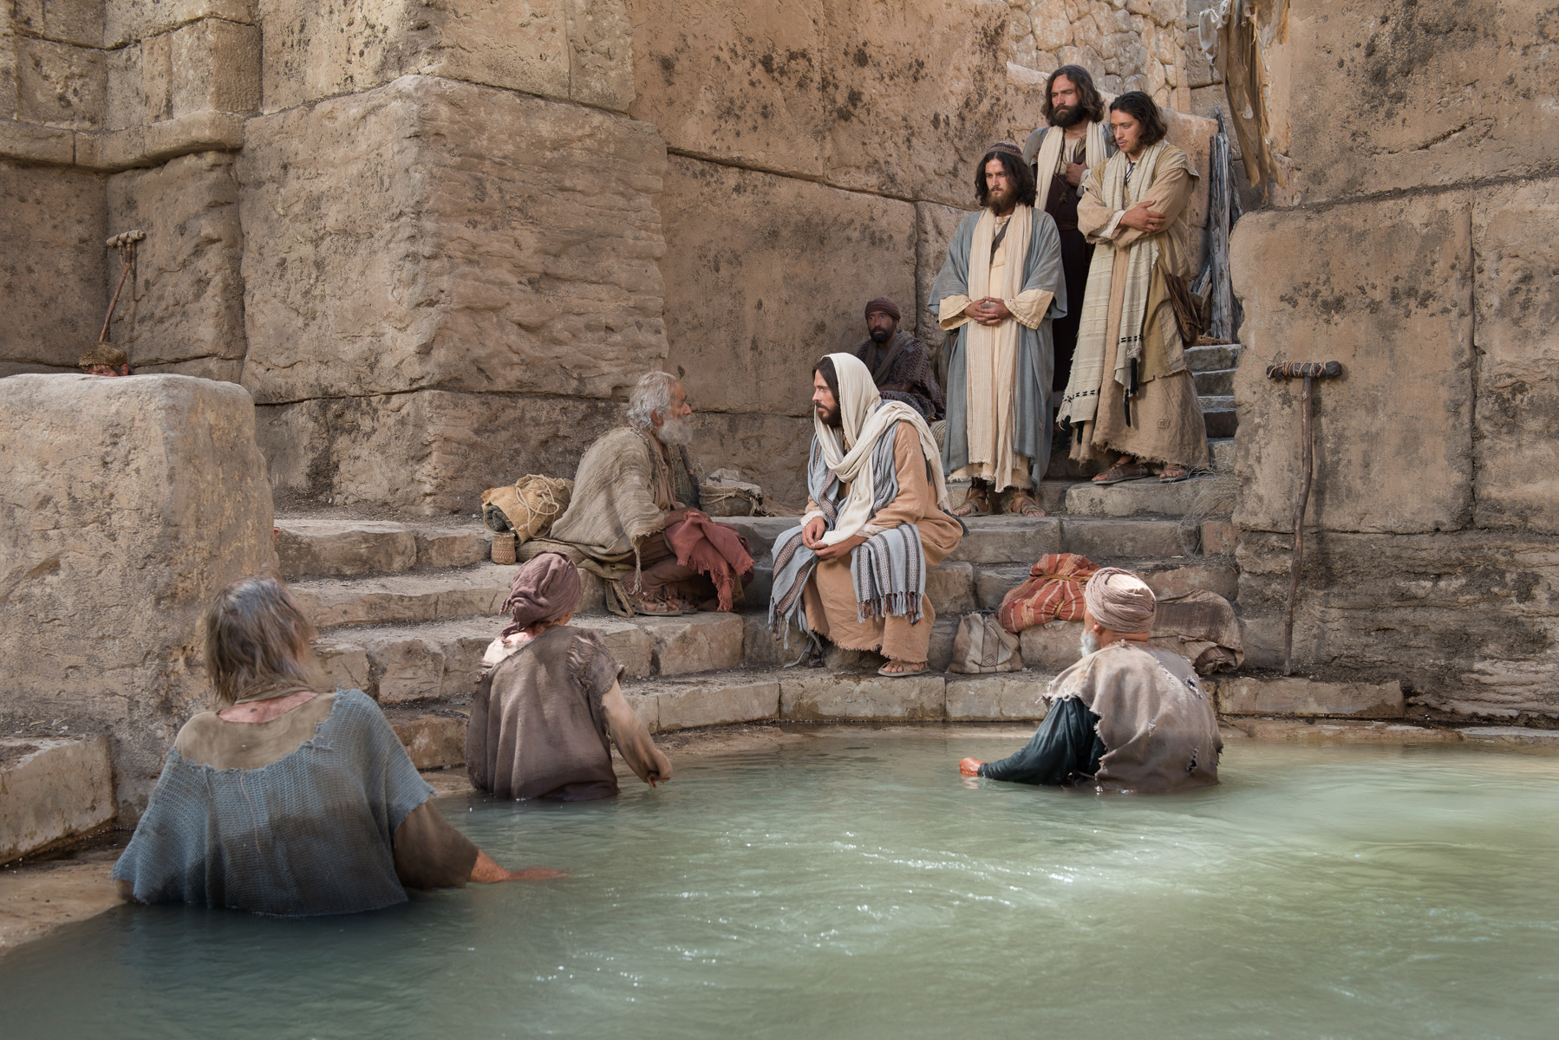
Don’t Miss It This Time

