Slide 1
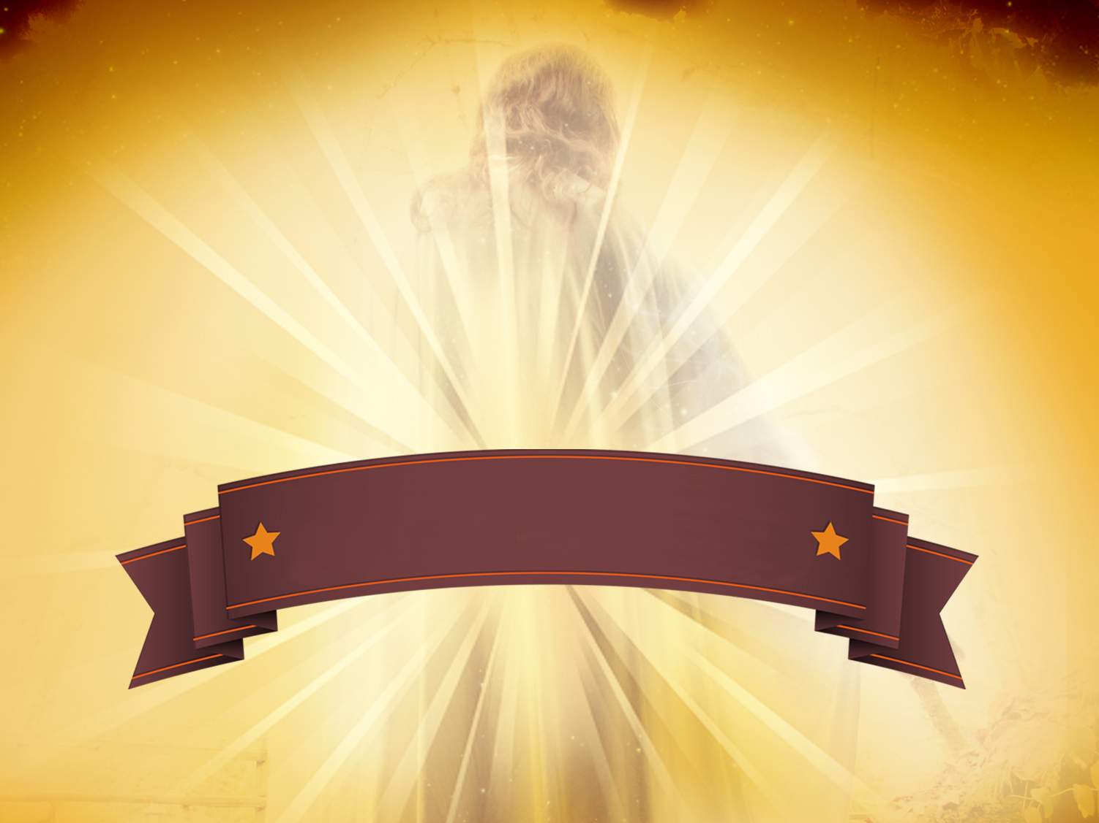
Where Do You Stand
On The
Resurrection
1 Corinthians 15:12-22
Sunday, April 5, 2015
Wayne Hartsgrove

Slide 2
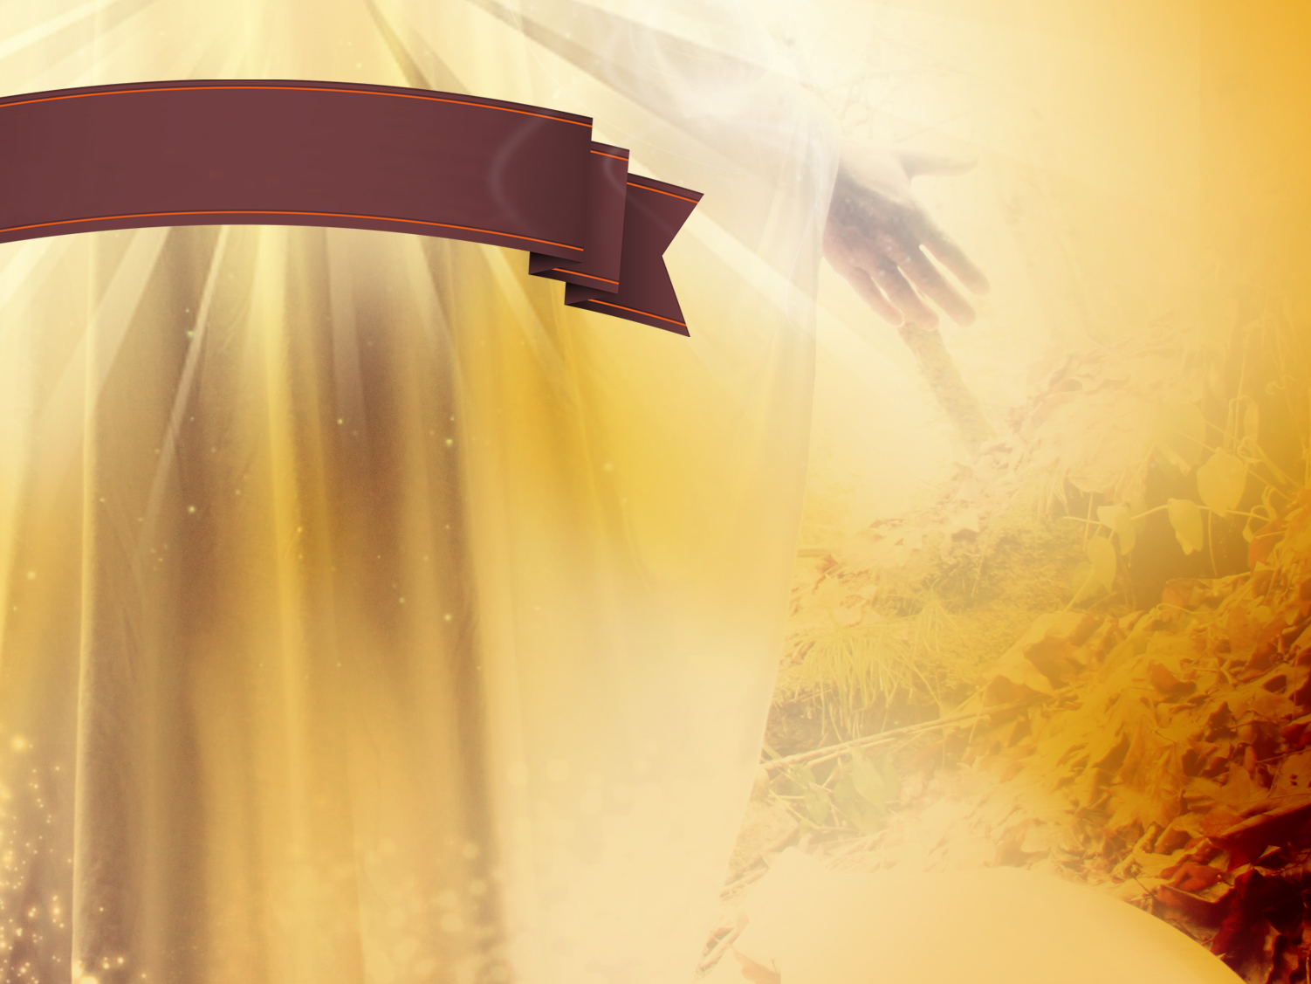
1 Corinthians 15:12-13 (NIV)
¹² But if it is preached that Christ has been raised from the dead, how can some of you say that there is no resurrection of the dead? ¹³ If there is no resurrection of the dead, then not even Christ has been raised.

Slide 3
1 Corinthians 15:14-15 (NIV)
¹⁴ And if Christ has not been raised, our preaching is useless and so is your faith. ¹⁵ More than that, we are then found to be false witnesses about God, for we have testified about God that he raised Christ from the dead. But he did not raise him if in fact the dead are not raised.

Slide 4
1 Corinthians 15:16-19 (NIV)
¹⁶ For if the dead are not raised, then Christ has not been raised either. ¹⁷ And if Christ has not been raised, your faith is futile; you are still in your sins. ¹⁸ Then those also who have fallen asleep in Christ are lost. ¹⁹ If only for this life we have hope in Christ, we are of all people most to be pitied.

Slide 5
1 Corinthians 15:20-22 (NIV)
²⁰ But Christ has indeed been raised from the dead, the firstfruits of those who have fallen asleep. ²¹ For since death came through a man, the resurrection of the dead comes also through a man. ²² For as in Adam all die, so in Christ all will be made alive.

Slide 6
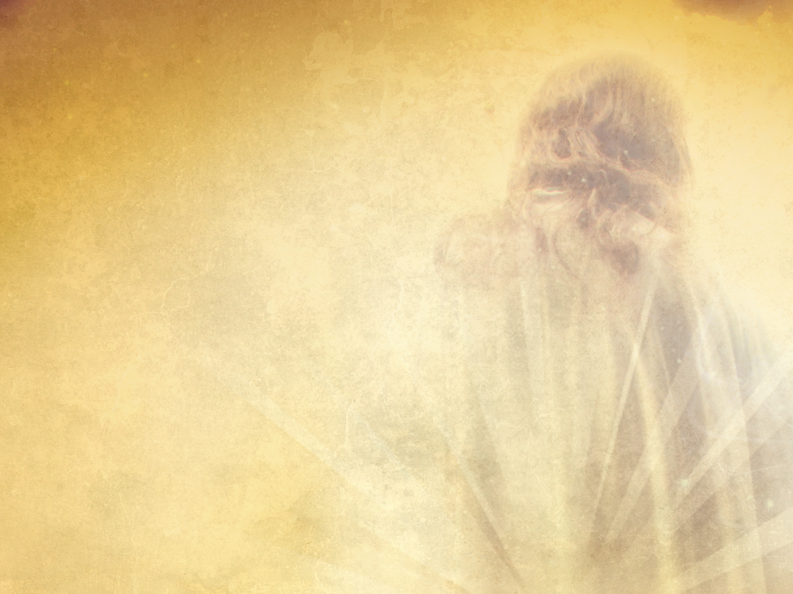

Slide 7
Psalm 10:4 (NKJV)
⁴ The wicked in his proud countenance does not seek God;
God is in none of his thoughts.

Slide 8
Romans 8:20-21 (NKJV)
²⁰ For the creation was subjected to futility, not willingly, but because of Him who subjected it in hope; ²¹ because the creation itself also will be delivered from the bondage of corruption into the glorious liberty of the children of God.

Slide 9
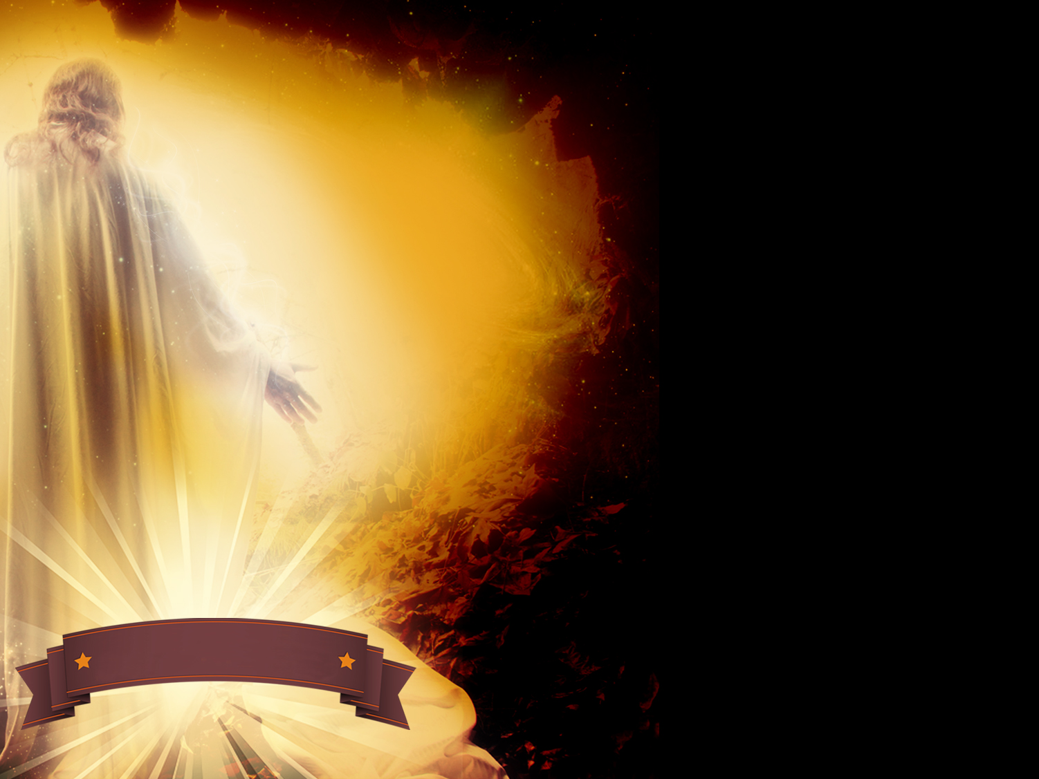
“Faith is not belief without proof, but trust without reservation.”
Elton Trueblood

Slide 10
The resurrection of Jesus is the most pivotal event in history. True or False

Slide 11
Faith in Christ’s resurrection is based on solid historical and experiential evidence.

Slide 12
If Christ was not raised from the dead, our faith is worth nothing and we’re still living in our sins.
(1 Cor 15:17)

Slide 13
1 Corinthians 15:17 (NKJV)
¹⁷ And if Christ is not risen, your faith is futile; you are still in your sins!

Slide 14
Confidence comes from following Christ and focusing on the resurrection.

Slide 15
Faith in the resurrection means we can live confidently.

Slide 16

Faith in the resurrection of Jesus means you and I may live
CONFIDENTLY

Slide 17
Faith in the resurrection means we can live gratefully.

Slide 18
Faith in the resurrection of Jesus means we can live
GRATEFULLY

Slide 19
“Before we can begin
to see the cross as something done for us, we have to see it as something done by us.”
John Stott

Slide 20
Faith in the resurrection means we should live hopefully.

Slide 21
Faith in the resurrection of Jesus means we should live
HOPEFULLY

Slide 22
HOPEFULLY
Why? Because we can live eternally with Jesus when we accept Him as our Savior.

Slide 23
On your own, memorize
1 Corinthians 15:22

Slide 24
1 Corinthians 15:22 (NKJV)
²² For as in Adam all die, even so in Christ all shall be made alive.

Slide 25
Faith in the resurrection means we can live eternally with Him when we repent of our sins and accept Him as our Savior.

Slide 26
Do you have faith in the resurrection of Jesus?

Slide 27

Where You Stand
On The Resurrection Will Determine Where You Spend Eternity!

