Slide 1
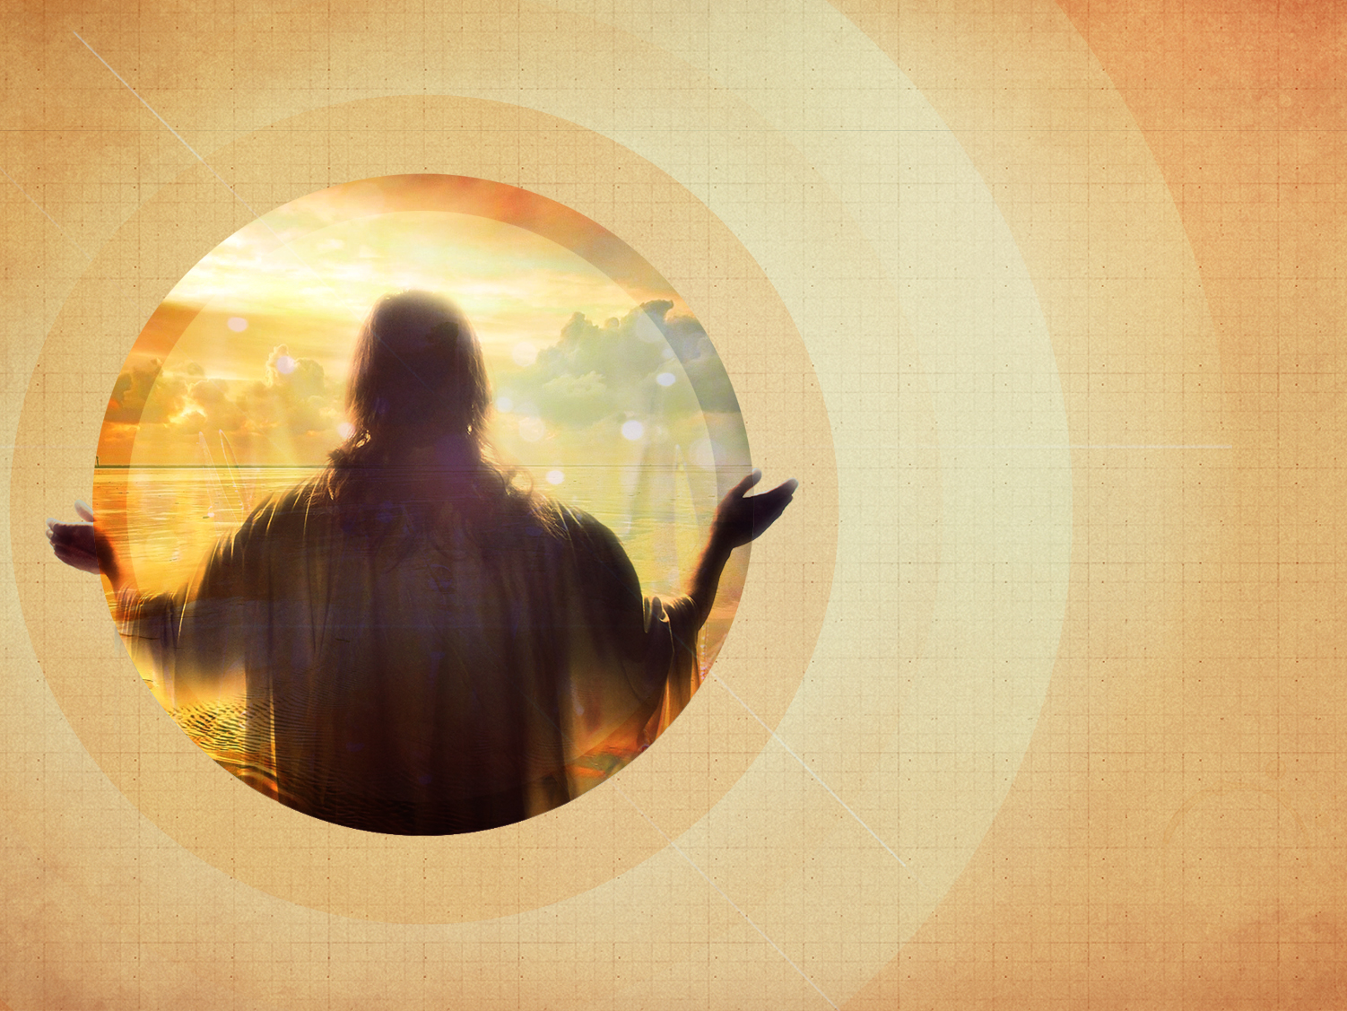
“I AM”
Is Our Life!
Exodus 3:13-17; John 8:56-59, 18:1-6
Sunday, April 19, 2015
Rich Rock

Slide 2

Exodus 3:13 (NKJV)
¹³ Then Moses said to God, “Indeed, when I come to the children of Israel and say to them, ‘The God of your fathers has sent me to you,’ and they say to me, ‘What is His name?’ what shall I say to them?”

Slide 3
Exodus 3:14 (NKJV)
¹⁴ And God said to Moses, “I AM WHO I AM.” And He said, “Thus you shall say to the children of Israel, ‘I AM has sent me to you.’”

Slide 4
Exodus 3:15 (NKJV)
¹⁵ Moreover God said to Moses, “Thus you shall say to the children of Israel: ‘The Lord God of your fathers, the God of Abraham, the God of Isaac, and the God of Jacob, has sent me to you. This is My name forever, and this is My memorial to all generations.’

Slide 5
Exodus 3:16 (NKJV)
¹⁶ Go and gather the elders of Israel together, and say to them, ‘The Lord God of your fathers, the God of Abraham, of Isaac, and of Jacob, appeared to me, saying, “I have surely visited you and seen what is done to you in Egypt;

Slide 6
Exodus 3:17 (NKJV)
¹⁷ and I have said I will bring you up out of the affliction of Egypt to the land of the Canaanites and the Hittites and the Amorites and the Perizzites and the Hivites and the Jebusites, to a land flowing with milk and honey.”’

Slide 7
John 8:56-57 (NKJV)
⁵⁶ Your father Abraham rejoiced to see My day, and he saw it and was glad.”
⁵⁷ Then the Jews said to Him, “You are not yet fifty years old, and have You seen Abraham?”

Slide 8
John 8:58-59 (NKJV)
⁵⁸ Jesus said to them, “Most assuredly, I say to you, before Abraham was, I AM.”
⁵⁹ Then they took up stones to throw at Him; but Jesus hid Himself and went out of the temple, going through the midst of them, and so passed by.

Slide 9
John 18:1-2 (NKJV)
18 When Jesus had spoken these words, He went out with His disciples over the Brook Kidron, where there was a garden, which He and His disciples entered. ² And Judas, who betrayed Him, also knew the place; for Jesus often met there with His disciples.

Slide 10
John 18:3-4 (NKJV)
³ Then Judas, having received a detachment of troops, and officers from the chief priests and Pharisees, came there with lanterns, torches, and weapons. ⁴ Jesus therefore, knowing all things that would come upon Him, went forward and said to them, “Whom are you seeking?”

Slide 11
John 18:5-6 (NKJV)
⁵ They answered Him, “Jesus of Nazareth.”
Jesus said to them, “I am He.” And Judas, who betrayed Him, also stood with them. ⁶ Now when He said to them, “I am He,” they drew back and fell to the ground.

Slide 12


Slide 13
John 8:58; 18:6 (NKJV)
⁵⁸ Jesus said to them, “Most assuredly, I say to you, before Abraham was, I AM.”
⁶ Now when He said to them, “I am He,” they drew back and fell to the ground.

Slide 14
Exodus 3:14 (NKJV)
¹⁴ And God said to Moses, “I AM WHO I AM.” And He said, “Thus you shall say to the children of Israel, ‘I AM has sent me to you.’”

Slide 15
John 8:58 (NKJV)
⁵⁸ Jesus said to them, “Most assuredly, I say to you, before Abraham was, I AM.”

Slide 16
John 6:35, 48 (NKJV)
³⁵ And Jesus said to them, “I am the bread of life. He who comes to Me shall never hunger, and he who believes in Me shall never thirst.
⁴⁸ I am the bread of life.

Slide 17
John 8:12; 9:5 (NKJV)
¹² Then Jesus spoke to them again, saying, “I am the light of the world. He who follows Me shall not walk in darkness, but have the light of life.”
⁵ As long as I am in the world, I am the light of the world.”

Slide 18
John 11:25 (NKJV)
²⁵ Jesus said to her, “I am the resurrection and the life. He who believes in Me, though he may die, he shall live.

Slide 19
John 14:6 (NKJV)
⁶ Jesus said to him, “I am the way, the truth, and the life. No one comes to the Father except through Me.

Slide 20
John 1:1 (NKJV)
1 In the beginning was the Word, and the Word was with God, and the Word was God.

Slide 21
John 18:6 (NKJV)
⁶ Now when He said to them, “I am He,” they drew back and fell to the ground.

Slide 22
Romans 8:31 (NKJV)
³¹ What then shall we say to these things? If God is for us, who can be against us?

Slide 24

The Old Testament is written mostly in Hebrew.

Slide 25
The New Testament is written in Greek.

Slide 26
The Greek for “I AM” in John 8:58 and 18:6 is Ego Eimi.

Slide 27
The Greek for “I AM” in Exodus 3:14 is Ego Eimi.

Slide 28
Every time Jesus said, “I AM” He was claiming to be God in the flesh – John 8:58!

Slide 29
Jesus said, I AM the Bread of life. He’s our provider –
John 6:35, 48

Slide 30
Jesus said, I AM the Light of the world. He’s our hope – John 8:12, 9:5

Slide 31
Jesus said, I AM the Resurrection and the Life. He’s our healer – John 11:25

Slide 32
Jesus said, I AM the Way, the Truth and the Life –
John 14:6

Slide 33
The only way to get to heaven is through Jesus, because Jesus is God –
John 1:1

Slide 34
When Jesus said, “I AM HE” in the garden the Roman Soldiers fell down to the ground –
John 18:6!

Slide 35
Jesus is the Great “I AM” and He is for us NOT against us – Romans 8:31!

Slide 36
“I AM”
Is Our Life!
Jesus said to him, “I am the way, the truth, and the life. No one comes to the Father except through Me.
John 14:6 (NKJV)

