Slide 1
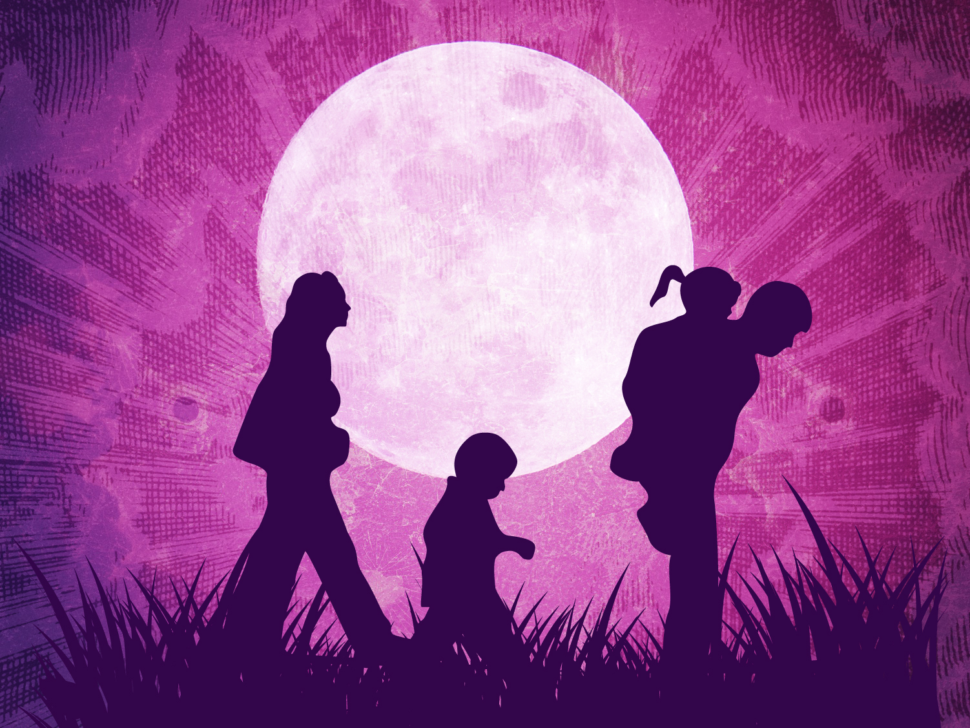
God’s
Family
Plan
Sunday, April 26, 2015
Wayne Hartsgrove

Slide 2

Genesis 2:18-19 (NKJV)
¹⁸ And the Lord God said, “It is not good that man should be alone; I will make him a helper comparable to him.” ¹⁹ Out of the ground the Lord God formed every beast of the field and every bird of the air, and brought them to Adam to see what he would call them. And whatever Adam called each living creature, that was its name.

Slide 3
Genesis 2:20 (NKJV)
²⁰ So Adam gave names to all cattle, to the birds of the air, and to every beast of the field. But for Adam there was not found a helper comparable to him.

Slide 4
Genesis 2:21-22 (NKJV)
²¹ And the Lord God caused a deep sleep to fall on Adam, and he slept; and He took one of his ribs, and closed up the flesh in its place. ²² Then the rib which the Lord God had taken from man He made into a woman, and He brought her to the man.

Slide 5
Genesis 2:23 (NKJV)
²³ And Adam said:
“This is now bone of my bones
And flesh of my flesh;
She shall be called Woman,
Because she was taken out of Man.”

Slide 6
Genesis 2:24 (NKJV)
²⁴ Therefore a man shall leave his father and mother and be joined to his wife, and they shall become one flesh.

Slide 7
Mark 10:6-9 (NKJV)
⁶ But from the beginning of the creation, God ‘made them male and female.’ ⁷ ‘For this reason a man shall leave his father and mother and be joined to his wife, ⁸ and the two shall become one flesh’; so then they are no longer two, but one flesh. ⁹ Therefore what God has joined together, let not man separate.”

Slide 8
Genesis 2:18-19 (NKJV)
¹⁸ And the Lord God said, “It is not good that man should be alone; I will make him a helper comparable to him.” ¹⁹ Out of the ground the Lord God formed every beast of the field and every bird of the air, and brought them to Adam to see what he would call them. And whatever Adam called each living creature, that was its name.

Slide 9
Genesis 2:20 (NKJV)
²⁰ So Adam gave names to all cattle, to the birds of the air, and to every beast of the field. But for Adam there was not found a helper comparable to him.

Slide 10
Genesis 2:21-22 (NKJV)
²¹ And the Lord God caused a deep sleep to fall on Adam, and he slept; and He took one of his ribs, and closed up the flesh in its place. ²² Then the rib which the Lord God had taken from man He made into a woman, and He brought her to the man.

Slide 11
Genesis 2:7 (NKJV)
⁷ And the Lord God formed man of the dust of the ground, and breathed into his nostrils the breath of life; and man became a living being.

Slide 12
Genesis 3:8 (NKJV)
⁸ And they heard the sound of the Lord God walking in the garden in the cool of the day, and Adam and his wife hid themselves from the presence of the Lord God among the trees of the garden.

Slide 13
Genesis 1:28 (NKJV)
²⁸ Then God blessed them, and God said to them, “Be fruitful and multiply; fill the earth and subdue it; have dominion over the fish of the sea, over the birds of the air, and over every living thing that moves on the earth.”

Slide 14
Genesis 3:20 (NKJV)
²⁰ And Adam called his wife’s name Eve, because she was the mother of all living.

Slide 15
Genesis 3:21 (NKJV)
²¹ Also for Adam and his wife the Lord God made tunics of skin, and clothed them.

Slide 16
Genesis 4:1 (NKJV)
4 Now Adam knew Eve his wife, and she conceived and bore Cain, and said, “I have acquired a man from the Lord.”

Slide 17
Proverbs 22:6 (NKJV)
⁶ Train up a child in the way he should go,
And when he is old he will not depart from it.

Slide 18
Genesis 2:23 (NKJV)
²³ And Adam said:
“This is now bone of my bones
And flesh of my flesh;
She shall be called Woman,
Because she was taken out of Man.”

Slide 19
Genesis 2:24-25 (NKJV)
²⁴ Therefore a man shall leave his father and mother and be joined to his wife, and they shall become one flesh.
²⁵ And they were both naked, the man and his wife, and were not ashamed.

Slide 20
Philippians 2:3-4 (NKJV)
³ Let nothing be done through selfish ambition or conceit, but in lowliness of mind let each esteem others better than himself. ⁴ Let each of you look out not only for his own interests, but also for the interests of others.

Slide 21
Mark 10:6-9 (NKJV)
⁶ But from the beginning of the creation, God ‘made them male and female.’ ⁷ ‘For this reason a man shall leave his father and mother and be joined to his wife, ⁸ and the two shall become one flesh’; so then they are no longer two, but one flesh. ⁹ Therefore what God has joined together, let not man separate.”

Slide 22
Romans 1:24 (NKJV)
²⁴ Therefore God also gave them up to uncleanness, in the lusts of their hearts, to dishonor their bodies among themselves,

Slide 23
Romans 1:26, 27 (NKJV)
²⁶ For this reason God gave them up to vile passions. For even their women exchanged the natural use for what is against nature. ²⁷ Likewise also the men, leaving the natural use of the woman, burned in their lust for one another, men with men committing what is shameful, and receiving in themselves the penalty of their error which was due.

Slide 24
Romans 1:32 (NKJV)
³² who, knowing the righteous judgment of God, that those who practice such things are deserving of death, not only do the same but also approve of those who practice them.

Slide 25
1 Corinthians 6:9 (NKJV)
⁹ Do you not know that the unrighteous will not inherit the kingdom of God? Do not be deceived. Neither fornicators, nor idolaters, nor adulterers, nor homosexuals, nor sodomites,

Slide 26
1 Timothy 1:10 (NKJV)
¹⁰ for fornicators, for sodomites, for kidnappers, for liars, for perjurers, and if there is any other thing that is contrary to sound doctrine,

Slide 27
Jude 1:7 (NKJV)
⁷ as Sodom and Gomorrah, and the cities around them in a similar manner to these, having given themselves over to sexual immorality and gone after strange flesh, are set forth as an example, suffering the vengeance of eternal fire.

Slide 28
Ephesians 5:31-32 (NKJV)
³¹ “For this reason a man shall leave his father and mother and be joined to his wife, and the two shall become one flesh.” ³² This is a great mystery, but I speak concerning Christ and the church.

Slide 29
Matthew 19:6-7 (NKJV)
⁶ So then, they are no longer two but one flesh. Therefore what God has joined together, let not man separate.”
⁷ They said to Him, “Why then did Moses command to give a certificate of divorce, and to put her away?”

Slide 30
Matthew 19:8 (NKJV)
⁸ He said to them, “Moses, because of the hardness of your hearts, permitted you to divorce your wives, but from the beginning it was not so.

Slide 31
Matthew 19:9 (NKJV)
⁹ And I say to you, whoever divorces his wife, except for sexual immorality, and marries another, commits adultery; and whoever marries her who is divorced commits adultery.”

Slide 32
Matthew 5:32 (NKJV)
³² But I say to you that whoever divorces his wife for any reason except sexual immorality causes her to commit adultery; and whoever marries a woman who is divorced commits adultery.

Slide 33
1 Corinthians 7:15 (NKJV)
¹⁵ But if the unbeliever departs, let him depart; a brother or a sister is not under bondage in such cases. But God has called us to peace.

Slide 34
Mark 10:11-12 (NKJV)
¹¹ So He said to them, “Whoever divorces his wife and marries another commits adultery against her. ¹² And if a woman divorces her husband and marries another, she commits adultery.”

Slide 35
Luke 16:18 (NKJV)
¹⁸ “Whoever divorces his wife and marries another commits adultery; and whoever marries her who is divorced from her husband commits adultery.

Slide 36
Matthew 19:9 (NKJV)
⁹ And I say to you, whoever divorces his wife, except for sexual immorality, and marries another, commits adultery; and whoever marries her who is divorced commits adultery.”

Slide 37
1 Timothy 3:2, 12 (NKJV)
² A bishop then must be blameless, the husband of one wife, temperate, sober-minded, of good behavior, hospitable, able to teach;
¹² Let deacons be the husbands of one wife, ruling their children and their own houses well.

Slide 38
Titus 1:6 (NKJV)
⁶ if a man is blameless, the husband of one wife, having faithful children not accused of dissipation or insubordination.

Slide 39
Malachi 2:14 (NKJV)
¹⁴ Yet you say, “For what reason?”
Because the Lord has been witness
Between you and the wife of your youth,
With whom you have dealt treacherously;
Yet she is your companion
And your wife by covenant.

Slide 40
Malachi 2:15 (NKJV)
¹⁵ But did He not make them one,
Having a remnant of the Spirit?
And why one?
He seeks godly offspring.
Therefore take heed to your spirit,
And let none deal treacherously with the wife of his youth.

Slide 41
Malachi 2:16 (NKJV)
¹⁶ “For the Lord God of Israel says
That He hates divorce,
For it covers one’s garment with violence,”
Says the Lord of hosts.
“Therefore take heed to your spirit,
That you do not deal treacherously.”

Slide 43
Man was created by God on the 6th day of creation.

Slide 44
What causes loneliness?
  The unmet need to belong
  Not liking ourselves
  The vacuum in the heart
  Lack of roots due to a mobile society
  The death of a loved one, especially a spouse
  Lack of communication with family especially our spouse
  Singleness

Slide 45
The cure for loneliness is to risk reaching out to someone. Don’t be afraid to be yourself and to reveal yourself.

Slide 46
Woman was designed to be a helper who would make man complete.

Slide 47
Memorize Proverbs 22:6

Slide 48
God created Eve out of Adam’s feet so he could walk on her.
True or False

Slide 49
How much input should parents have in their son’s or daughter’s marriage?
None, only if asked.

Slide 50
Marriage is not condoned (accepted) in the Bible for homosexual. What is one of the scriptures do we use to support this?
Romans 1:26, 27, 32; 1 Corinthians 6:9;
1 Timothy 1:10; Jude 1:7

Slide 51
The Bible supports couples living together before marriage?
True or False?

Slide 52
God loves divorce.
True or False
What scripture reference do we use to support this?
Malachi 2:14-16

Slide 53
Husbands are to love and respect their wives; husbands are to love their wives as Christ loved the Church.

Slide 54

But as for me and my family, we will serve the Lord.
Joshua 24:15 (NLT)

