Slide 1
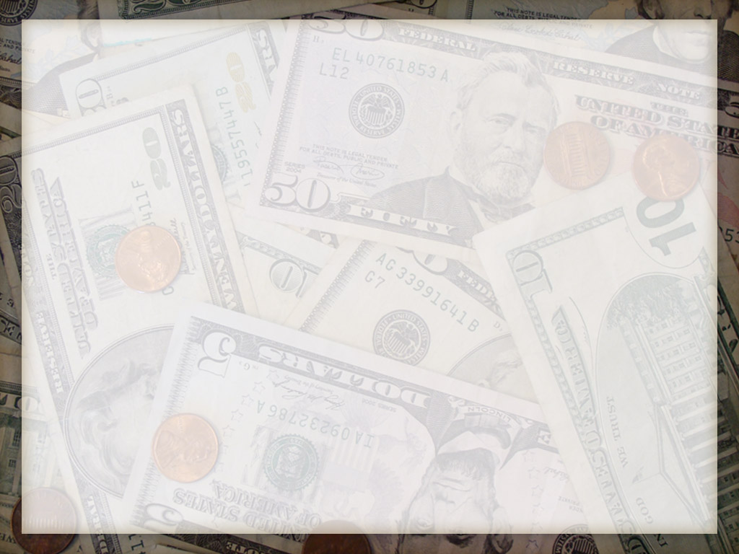
The Family and Finances
1 Corinthians 4:2
Sunday, July 12, 2015
Wayne Hartsgrove

Slide 2
1 Corinthians 4:2
² Moreover it is required in stewards that one be found faithful

Slide 3
I. Possessions We Hold
II. Obligations We Make
III. Gifts We Bring

Slide 4
QUESTIONS

Slide 5
SERMON NOTES #1
What are the purposes in the Christian life?
Care for the FAMILY
Care for the NEEDY
Support the work of the
KINGDOM OF GOD

Slide 6
SERMON NOTES #2
MONEY and COMMUNICATION are the two big issues in a relationship

Slide 7
SERMON NOTES #3
Selfishness in a family shows itself in
GREED

Slide 8
SERMON NOTES #4
Three important guidelines for handling money:
Money should be gained HONESTLY
Money should be spent REALISTICALLY
Money should be shared JOYFULLY

Slide 9
SERMON NOTES #5
Memorize Matthew 6:21
“For where your treasure is, there your heart will be also”

Slide 10
SERMON NOTES #6
The word “covet” means WANTING what someone else has

Slide 11
Exodus 20:17
¹⁷ “You shall not covet your neighbor’s house; you shall not covet your neighbor’s wife, nor his male servant, nor his female servant, nor his ox, nor his donkey, nor anything that is your neighbor’s.”

Slide 12
SERMON NOTES #7
Live within your MEANS (budget)

Slide 13
SERMON NOTES #8
It’s important to develop a BUDGET and live by it

Slide 14
SERMON NOTES #9
Put God first and set aside your TITHE from each paycheck

Slide 15
SERMON NOTES #10
Tithing is giving a TENTH of one’s income

Slide 16
SERMON NOTES #11
Our tithe belongs to the STOREHOUSE, the CHURCH, where we are being fed spiritually according to Malachi 3:8-10

Slide 17
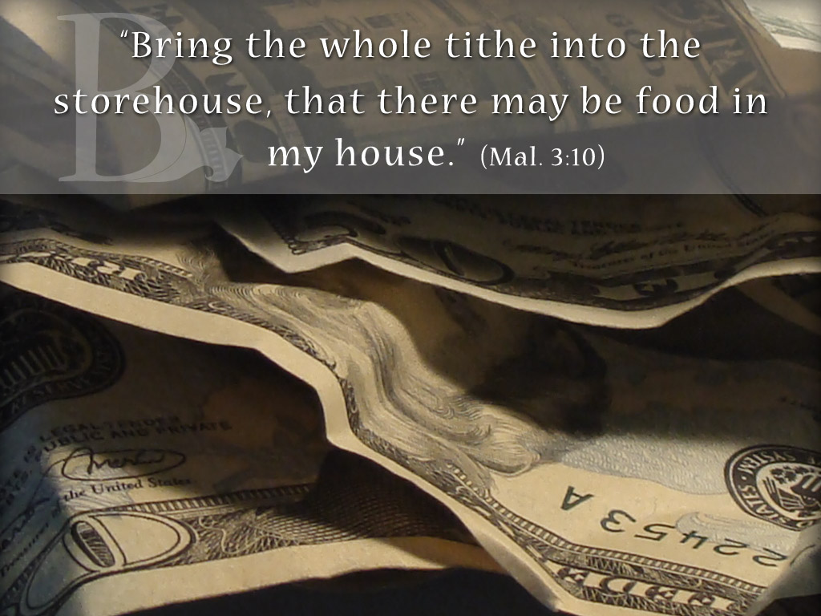

Slide 18
EXTRA SCRIPTURES
(in the same order as reverse side of Sermon Notes)

Slide 19
Matthew 15:3-4
³ He answered and said to them, “Why do you also transgress the commandment of God because of your tradition? ⁴ For God commanded, saying, ‘Honor your father and your mother’; and, ‘He who curses father or mother, let him be put to death.’

Slide 20
Matthew 15:5-6
⁵ But you say, ‘Whoever says to his father or mother, “Whatever profit you might have received from me is a gift to God”— ⁶ then he need not honor his father or mother.’ Thus you have made the commandment of God of no effect by your tradition

Slide 21
Ephesians 4:28
²⁸ Let him who stole steal no longer, but rather let him labor, working with his hands what is good, that he may have something to give him who has need.

Slide 22
James 2:15-16
¹⁵ If a brother or sister is naked and destitute of daily food, ¹⁶ and one of you says to them, “Depart in peace, be warmed and filled,” but you do not give them the things which are needed for the body, what does it profit?

Slide 23
1 Timothy 5:17-18
¹⁷ Let the elders who rule well be counted worthy of double honor, especially those who labor in the word and doctrine. ¹⁸ For the Scripture says, “You shall not muzzle an ox while it treads out the grain,” and, “The laborer is worthy of his wages.”

Slide 24
1 Timothy 5:19-21
¹⁹ Do not receive an accusation against an elder except from two or three witnesses. ²⁰ Those who are sinning rebuke in the presence of all, that the rest also may fear.
²¹ I charge you before God and the Lord Jesus Christ and the elect angels that you observe these things without prejudice, doing nothing with partiality.

Slide 25
Luke 12:13-15
¹³ Then one from the crowd said to Him, “Teacher, tell my brother to divide the inheritance with me.”
¹⁴ But He said to him, “Man, who made Me a judge or an arbitrator over you?”¹⁵ And He said to them, “Take heed and beware of covetousness, for one’s life does not consist in the abundance of the things he possesses.”

Slide 26
Luke 12:13-15
¹³ Then one from the crowd said to Him, “Teacher, tell my brother to divide the inheritance with me.”
¹⁴ But He said to him, “Man, who made Me a judge or an arbitrator over you?”¹⁵ And He said to them, “Take heed and beware of covetousness, for one’s life does not consist in the abundance of the things he possesses.”

Slide 27
1 Timothy 6:6-8
⁶ Now godliness with contentment is great gain. ⁷ For we brought nothing into this world, and it is certain we can carry nothing out. ⁸ And having food and clothing, with these we shall be content.

Slide 28
1 Timothy 6:9-11
⁹ But those who desire to be rich fall into temptation and a snare, and into many foolish and harmful lusts which drown men in destruction and perdition. ¹⁰ For the love of money is a root of all kinds of evil, for which some have strayed from the faith in their greediness, and pierced themselves through with many sorrows.

Slide 29
Proverbs 10:9
⁹ He who walks with integrity walks securely, But he who perverts his ways will become known

Slide 30
Proverbs 11:1
Dishonest scales are an abomination to the Lord, But a just weight is His delight.

Slide 31
2 Corinthians 9:6-8
⁶ But this I say: He who sows sparingly will also reap sparingly, and he who sows bountifully will also reap bountifully. ⁷ So let each one give as he purposes in his heart, not grudgingly or of necessity; for God loves a cheerful giver. ⁸ And God is able to make all grace abound toward you, that you, always having all sufficiency in all things, may have an abundance for every good work.

Slide 32
2 Corinthians 9:9-11
⁹ As it is written:
“He has dispersed abroad, He has given to the poor; His righteousness endures forever.”
¹⁰ Now may He who supplies seed to the sower, and bread for food, supply and multiply the seed you have sown and increase the fruits of your righteousness,¹¹ while you are enriched in everything for all liberality, which causes thanksgiving through us to God.

Slide 33
Proverbs 22:7
⁷ The rich rules over the poor, And the borrower is servant to the lender.

Slide 34
Proverbs 22:26,27
²⁶ Do not be one of those who shakes hands in a pledge, One of those who is surety for debts; ²⁷ If you have nothing with which to pay, Why should he take away your bed from under you?

Slide 35
Genesis 3:6
⁶ So when the woman saw that the tree was good for food, that it was pleasant to the eyes, and a tree desirable to make one wise, she took of its fruit and ate. She also gave to her husband with her, and he ate.

Slide 36
Genesis 3:7-8
⁷ Then the eyes of both of them were opened, and they knew that they were naked; and they sewed fig leaves together and made themselves coverings.
⁸ And they heard the sound of the Lord God walking in the garden in the cool of the day, and Adam and his wife hid themselves from the presence of the Lord God among the trees of the garden

Slide 37
Joshua 7:21
²¹ When I saw among the spoils a beautiful Babylonian garment, two hundred shekels of silver, and a wedge of gold weighing fifty shekels, I coveted them and took them. And there they are, hidden in the earth in the midst of my tent, with the silver under it.”

Slide 38
1 Chronicles 29:14
¹⁴ But who am I, and who are my people, That we should be able to offer so willingly as this? For all things come from You, And of Your own we have given You.

Slide 39
Psalm 24:1
The earth is the Lord’s, and all its fullness, The world and those who dwell therein

Slide 40
2 Corinthians 8:12-14
¹² For if there is first a willing mind, it is accepted according to what one has, and not according to what he does not have.
¹³ For I do not mean that others should be eased and you burdened; ¹⁴ but by an equality, that now at this time your abundance may supply their lack, that their abundance also may supply your lack—that there may be equality.

Slide 41
Luke 3:11
¹¹ He answered and said to them, “He who has two tunics, let him give to him who has none; and he who has food, let him do likewise.”

